Slide 1

Business map for the sale of automotive products Li Haozhe

Slide 2
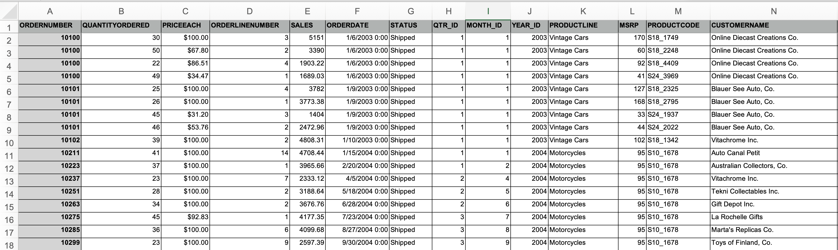
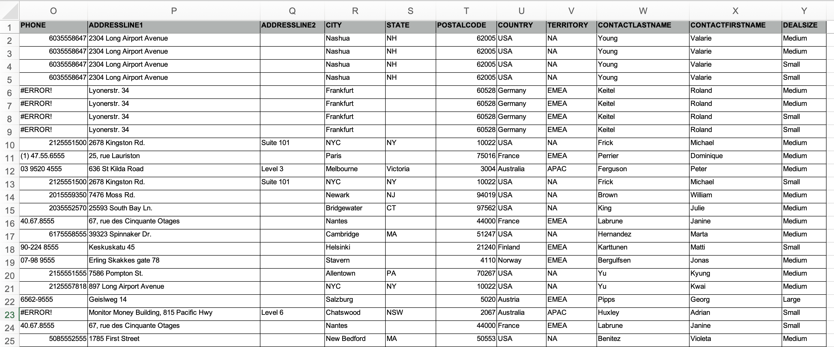

Slide 3


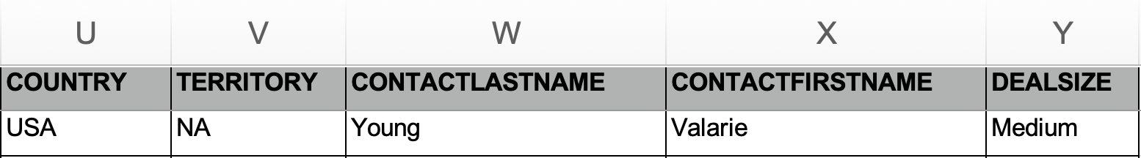

Slide 4
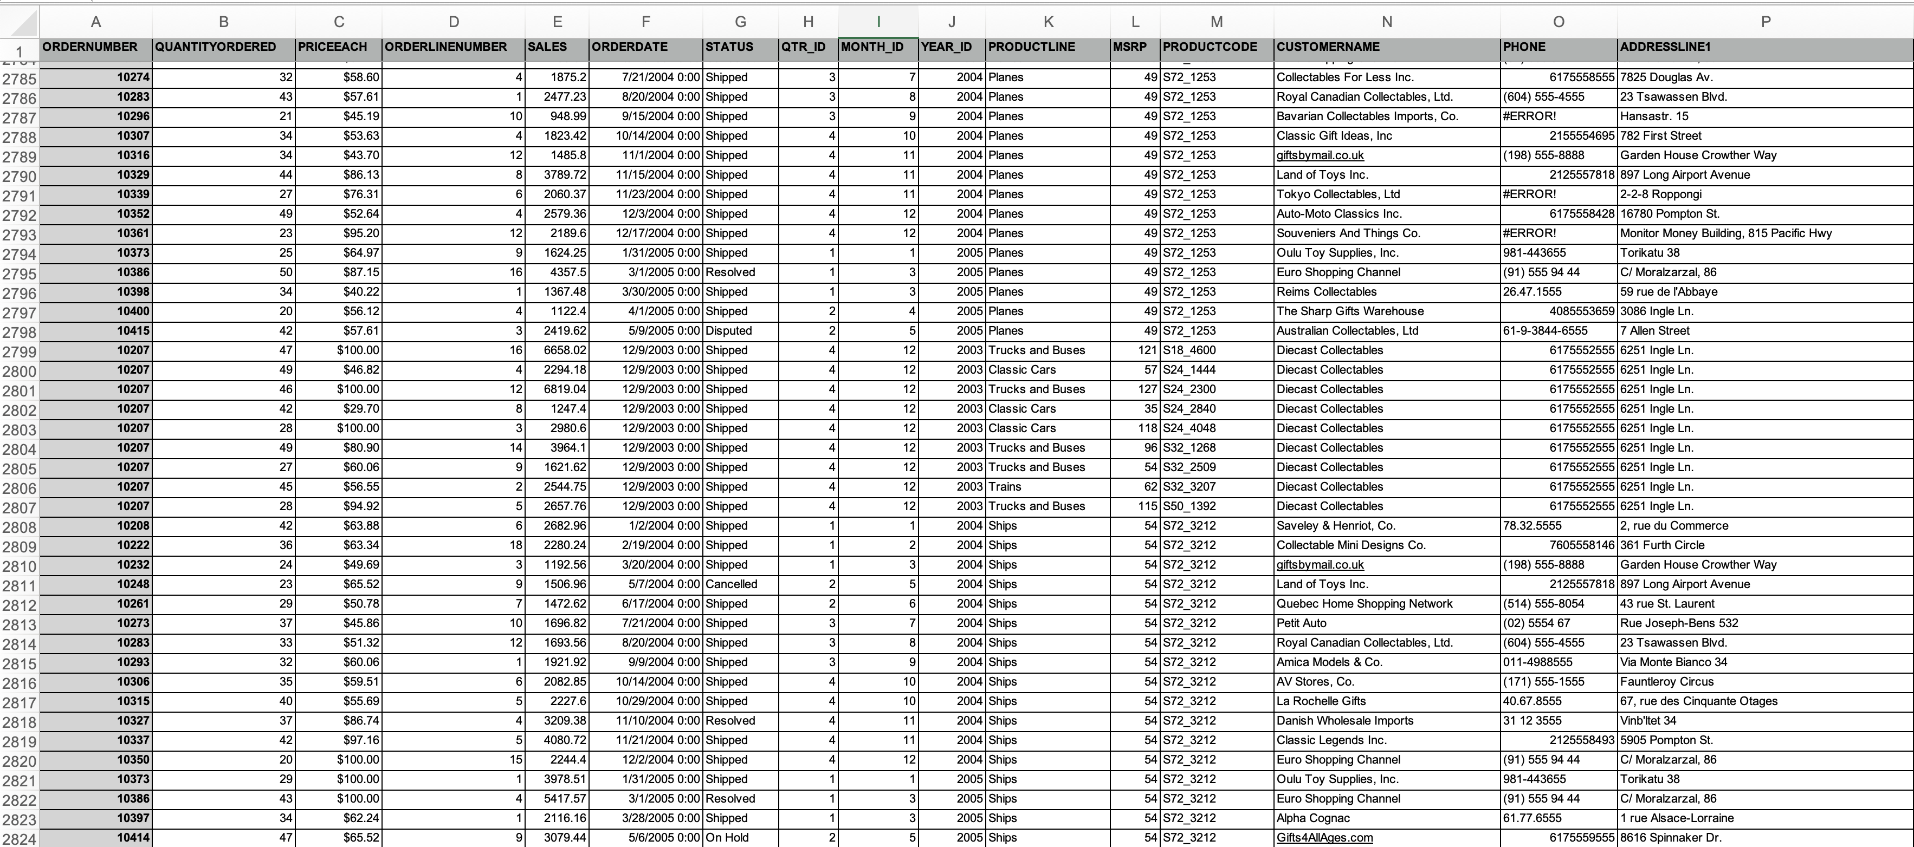

Slide 5
The most 4 interesting data of the products
1. Benefit of Country(How much momeny we can get from different countries）
2. Total Quantity Ordered by Top 5 Country（How many cars we have sold to different countries)
3. Top 5 Most Demanded Cars(Most popular cars）
4. Top 5 Companies by Sales Volume with Country Information
（Which company is the best and its in which country)

Slide 7
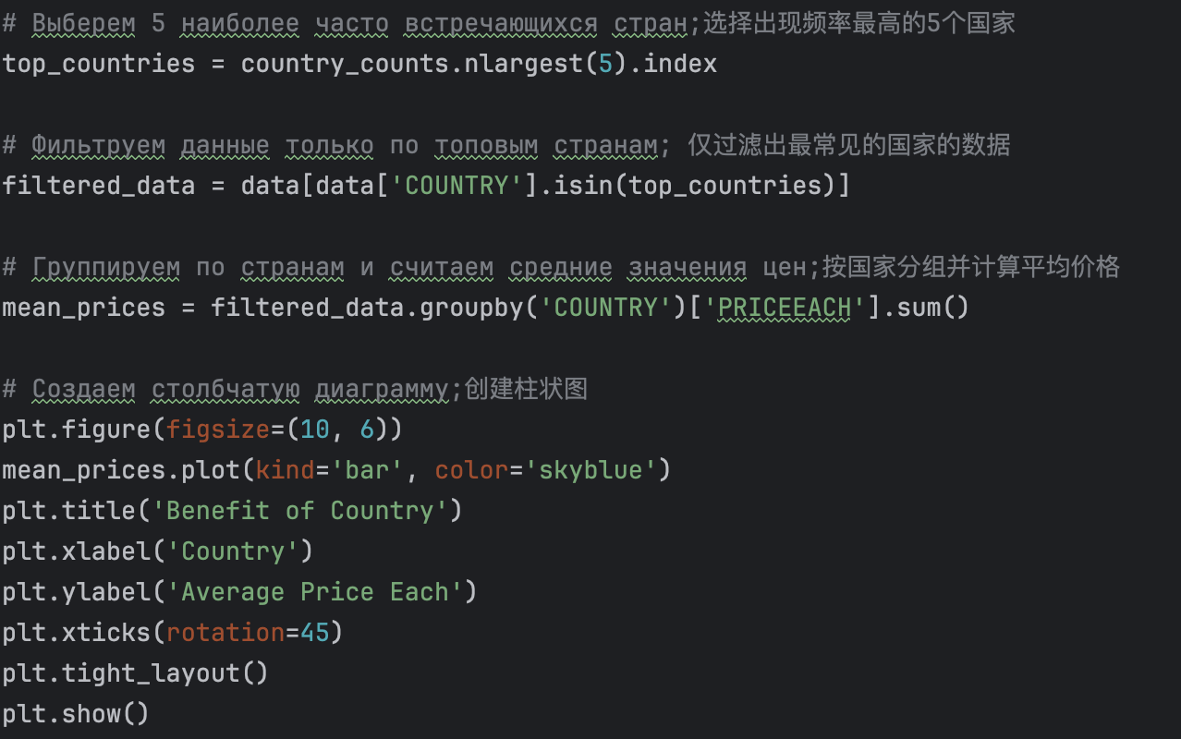

Slide 9
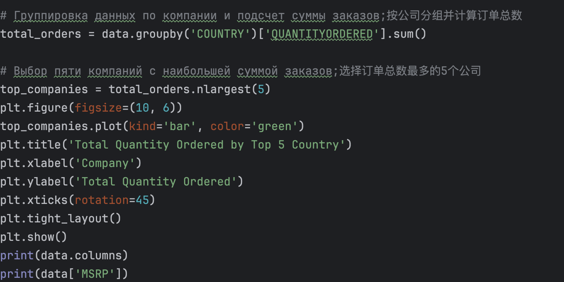

Slide 11
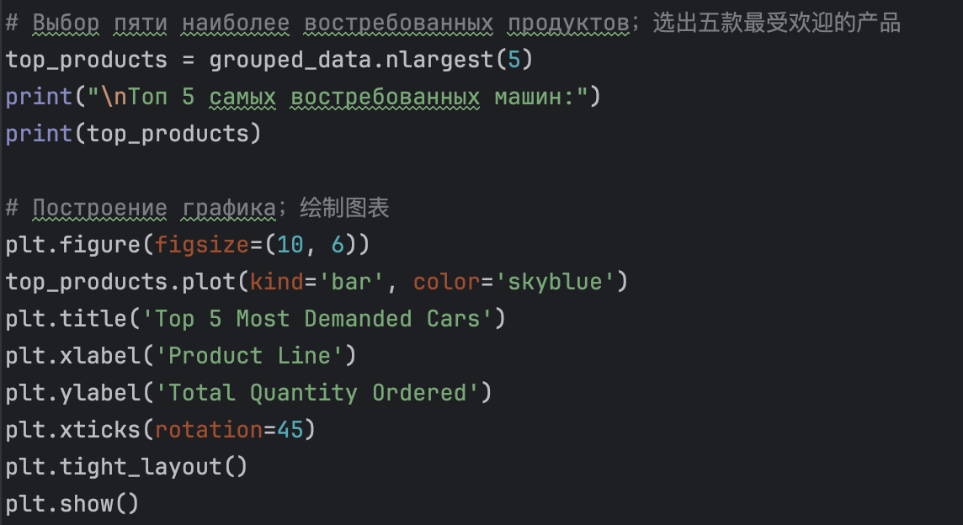

Slide 13
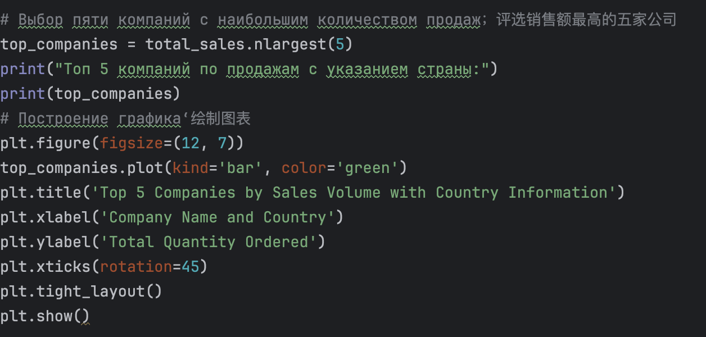

Slide 14
THANKS FOR LISTING!

